Slide 1

FINANCIAL RISK MANAGEMENT
USING MACHINE LEARNING
TEAM C4A1

Slide 2
TEAM MEMBERS
GVS Sai Madhav - 19BCN7228
D.N.V. Sai Harshith - 19BEC1335
Pramod.K - 18BEC1257
Prathulyan.n - 18BLC1023
Yeshwant.S.P - 18BLC1103

Slide 3

WHAT IS FINANCIAL RISK MANAGEMENT
Financial risk management is nothing but calculating a persons financial risk and making their financial status more manageable by using financial instruments.
Financial risks can be foreign exchange risk, business risk, legal risk, etc. Financial risk management can be either qualitative or quantitative .
Based on these, it helps people to manage their costly exposures to risk

Slide 4
EXISTING PROBLEM
People, these days face a lot of financial crisis. These can be either in the form of healthcare costs, debts or loans from banks or individuals, college or academic expenses, renting a house , or high costs of living .
Many don’t know how to manage all these finance related problems and hence face financial risks be it in business, marketing, education, etc. Learning to manage your money is like overcoming a big hurdle in your life.
The younger generations also face these risks in forms of student loans, or taking other loans when just beginning their career.
People don’t realize and don’t come to a conclusion about their financial status and hence fall into the risk.

Slide 5
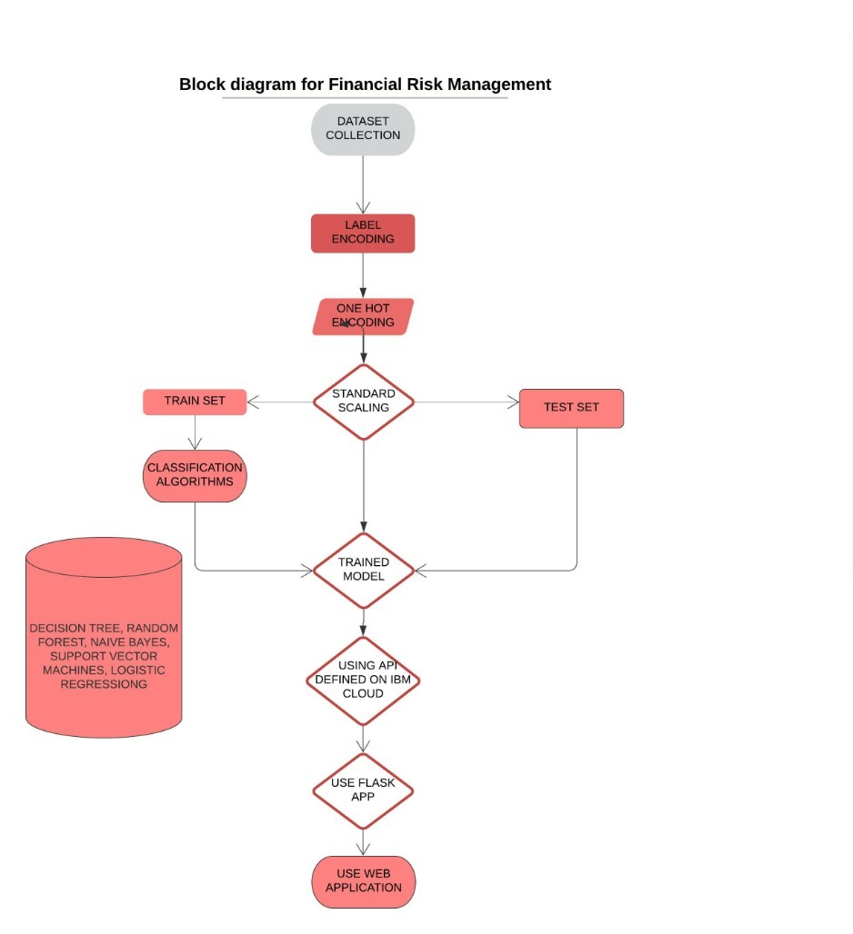
OUR APPROACH

Slide 6
DEMO

Slide 7
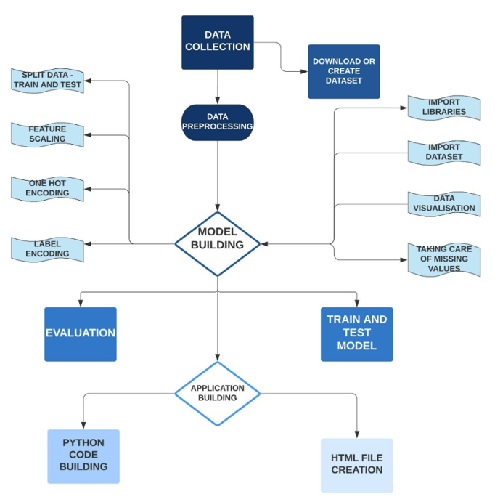
SUMMARY & ADVANTAGES
This model helpspeople to know their ﬁnancial statusand also helps them know if they are at a risk or not
It take in age, gender , housing etc to and helps customers to know if they are ﬁnancially stable or not
It secures the ﬁnancial position of the company by helping them know which

